Slide 1
Power School Seating Charts
How to create a seating chart template

Slide 2
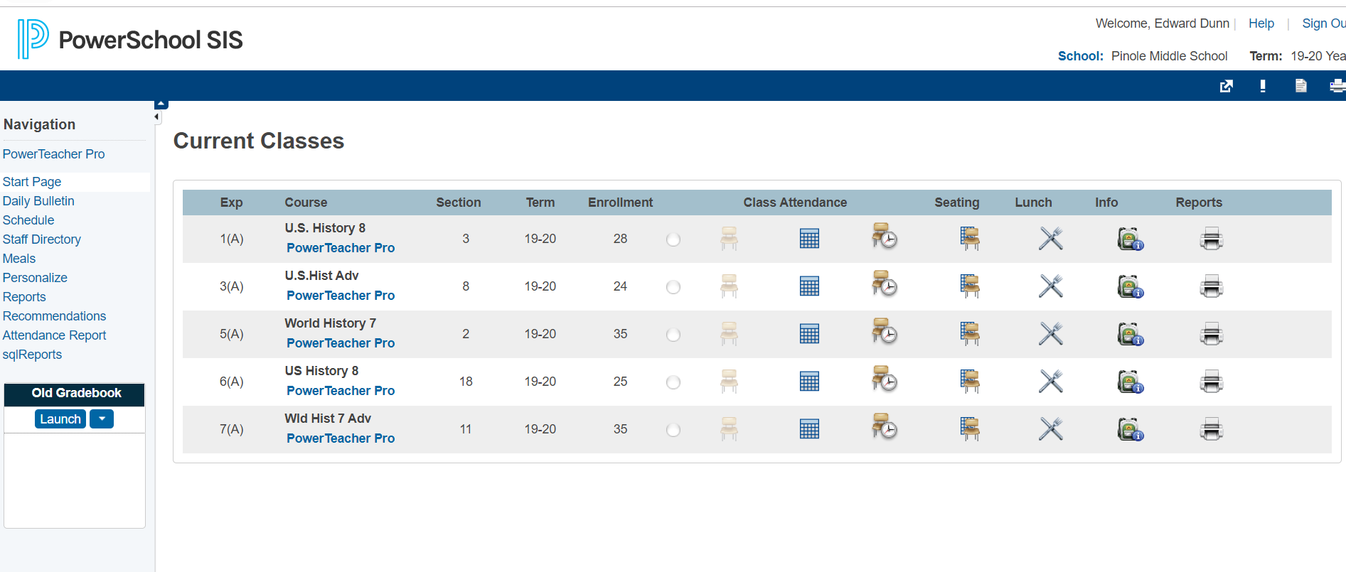
PowerSchool home page
Notes:
Start at the PowerSchool home page

Slide 3
PowerSchool home page

Slide 4
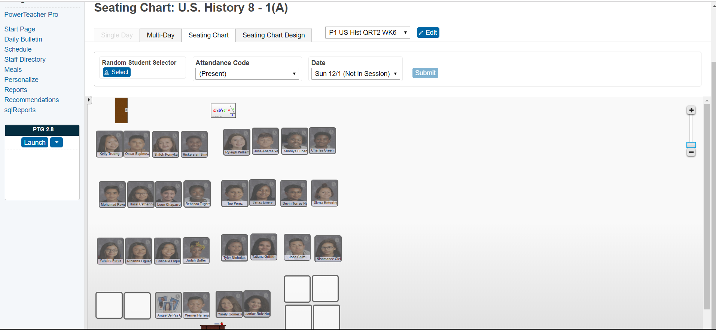
Pick new layout
Notes:
Go to the dropdown menu and click to new layout

Slide 5
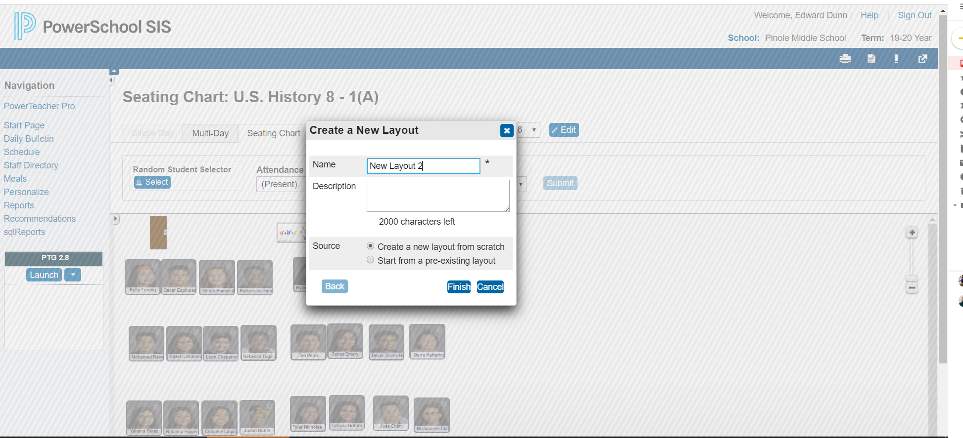
Pick source

Slide 6
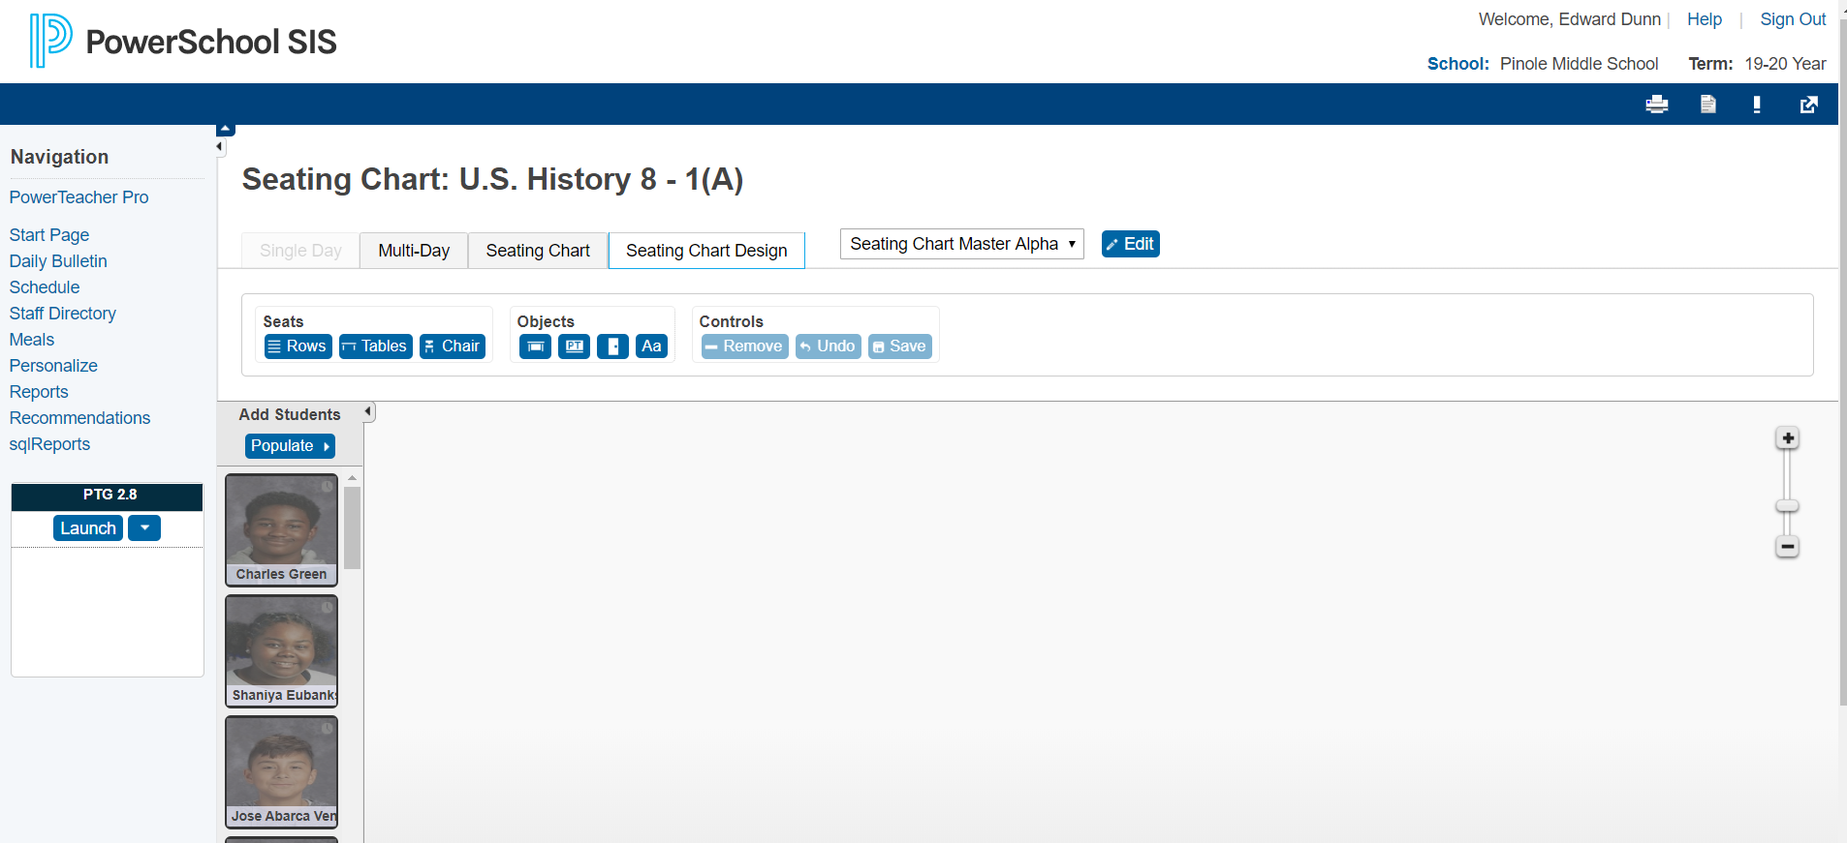
Create the template

Slide 7
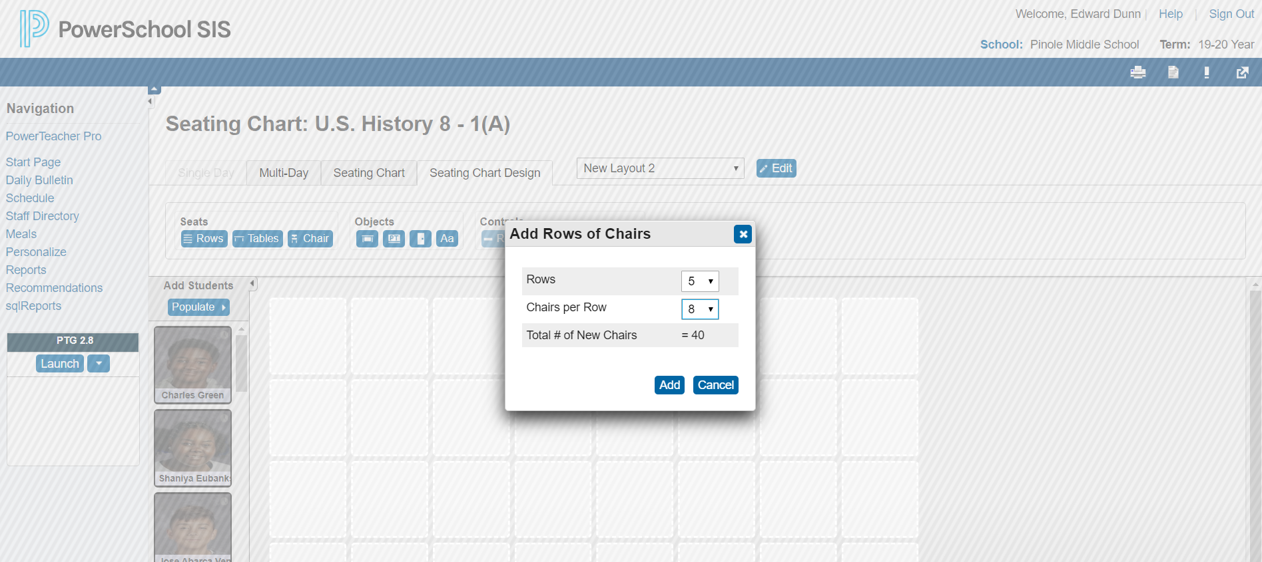
Pick add rows of chairs
Notes:
This is the best way to create a template then you can adjust it

Slide 8
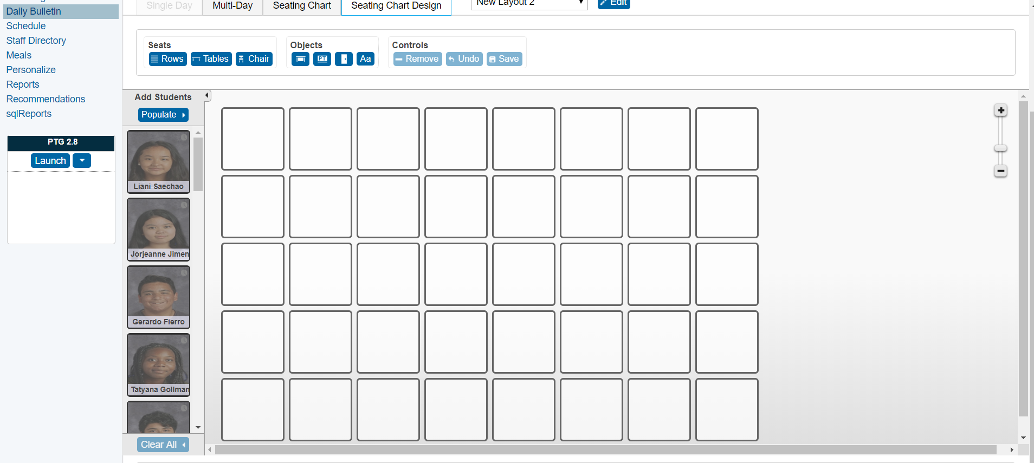
Now to populate
Notes:
This is the best way to create a template then you can adjust it

Slide 9
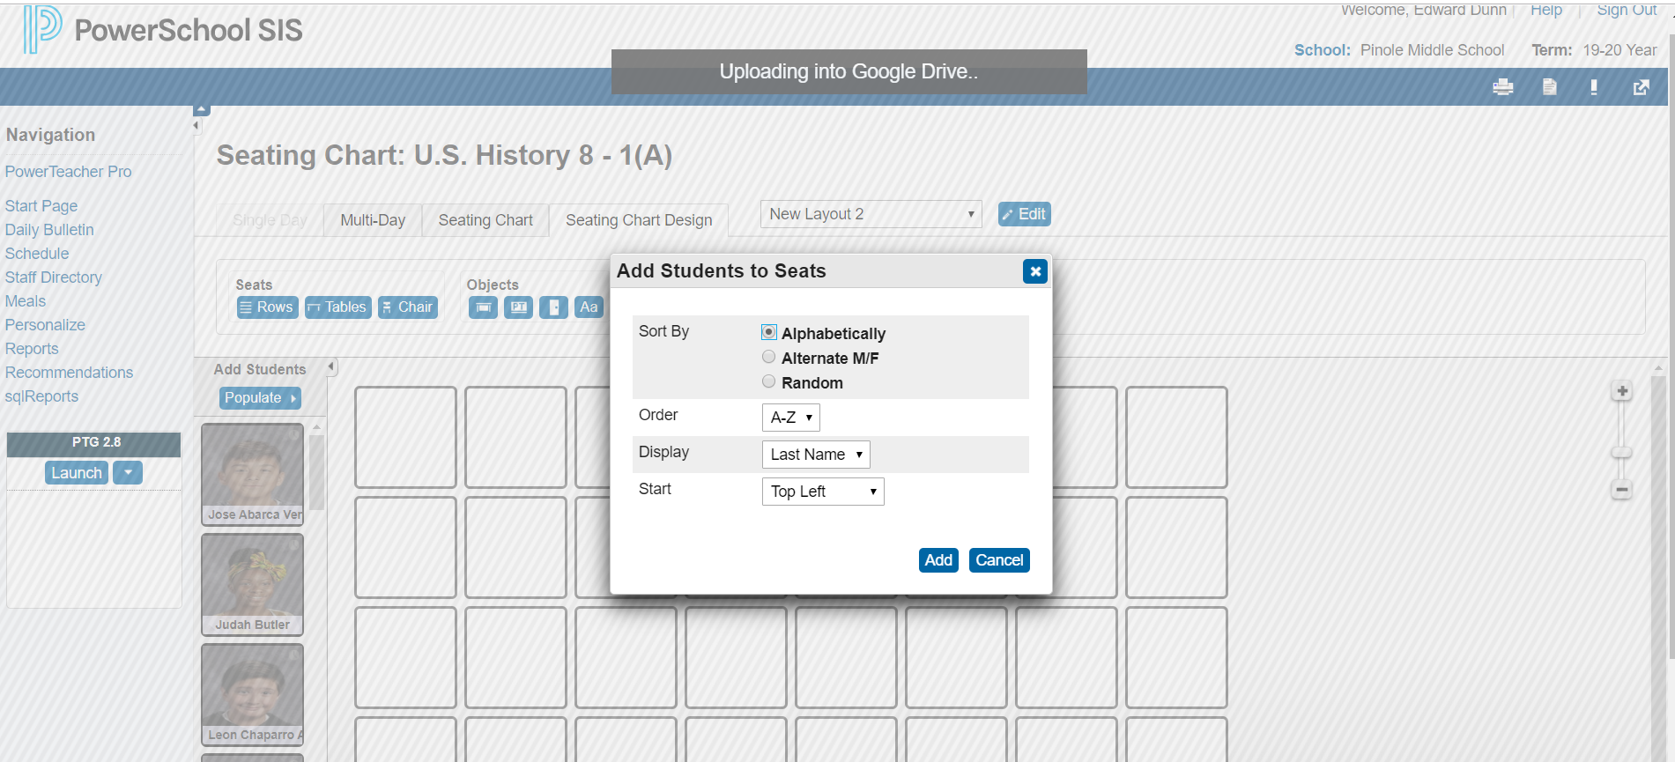
Now to populate
Notes:
This is the best way to create a template then you can adjust it

Slide 10
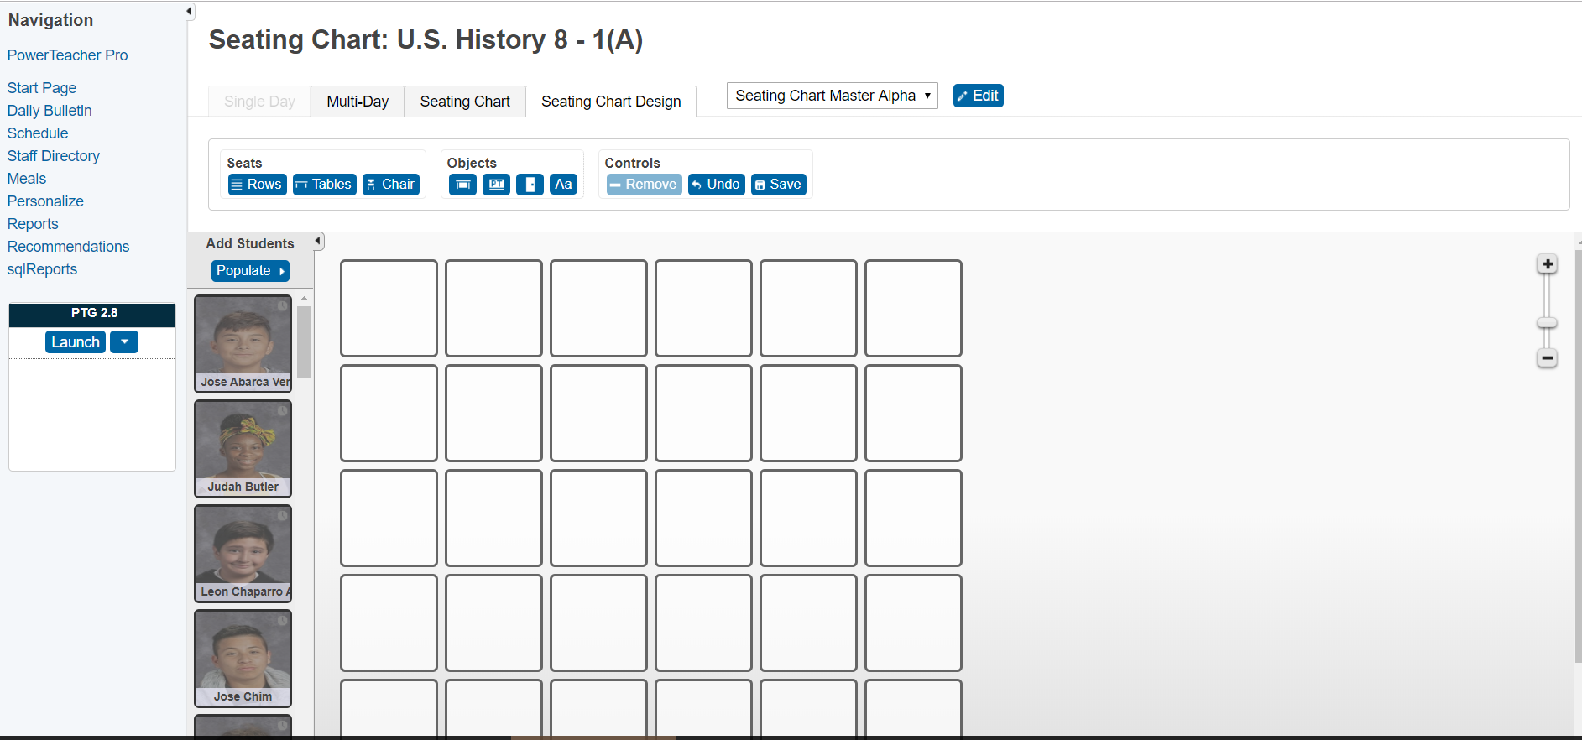
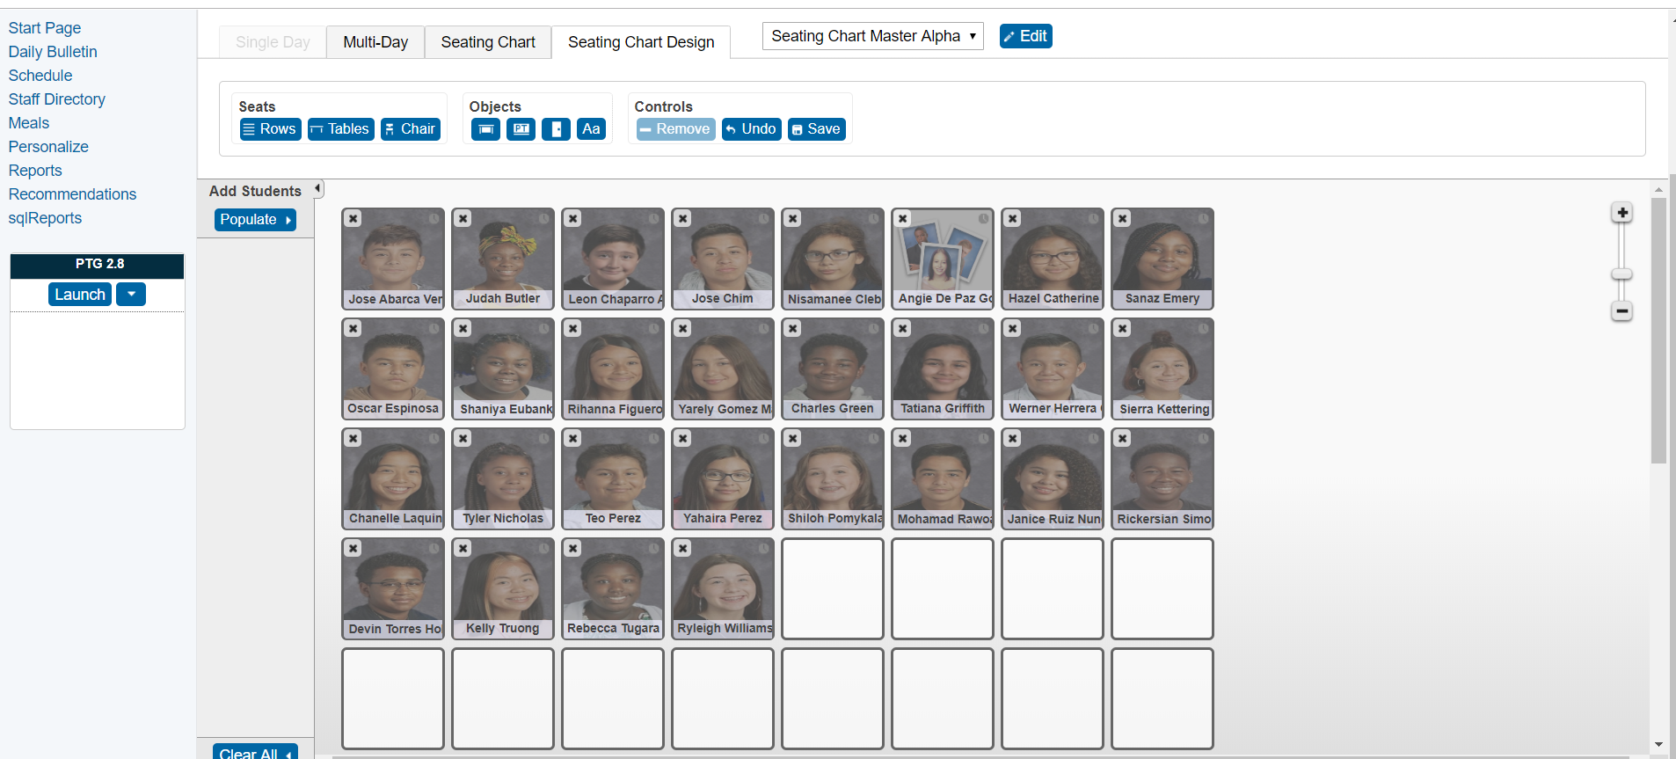
5 X 8 template

Slide 11
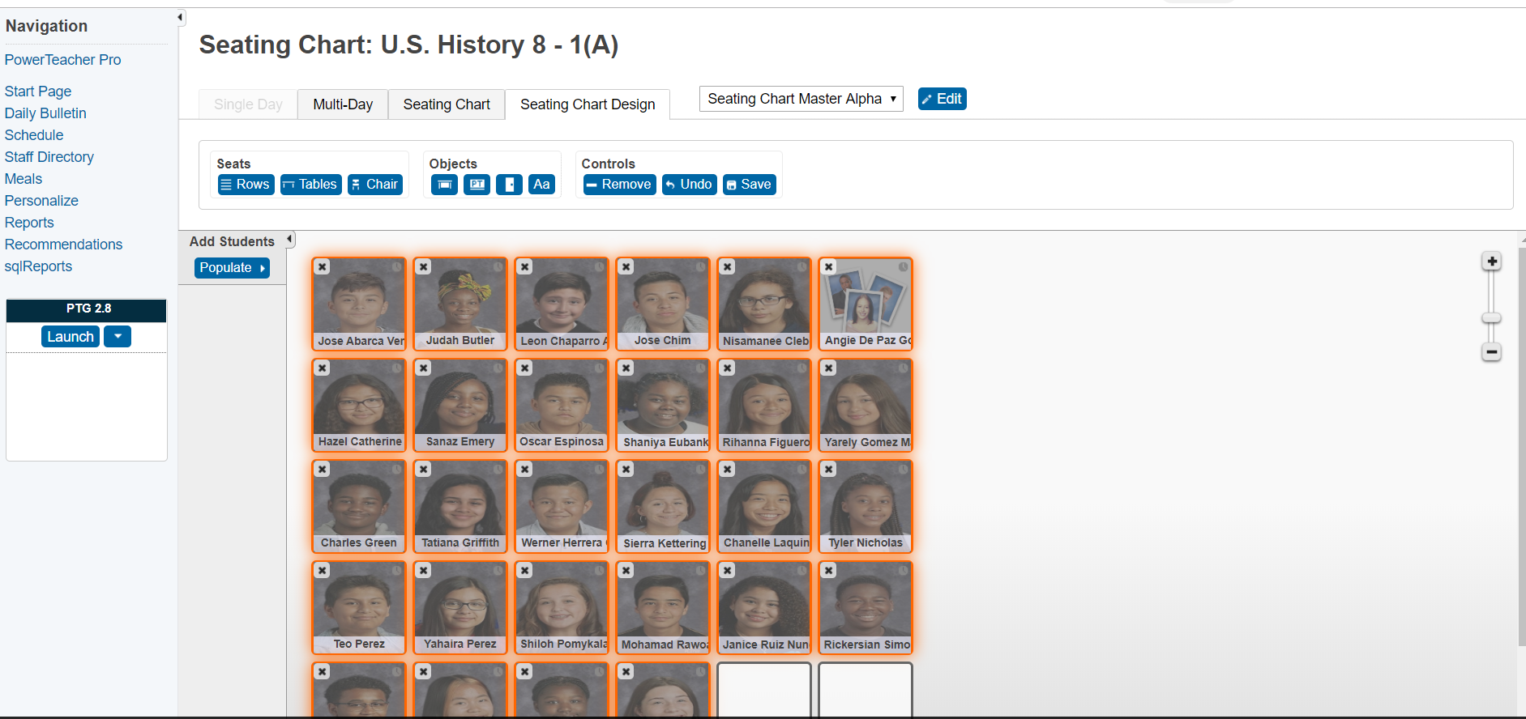
6 X 5 template

Slide 12
Do not forget to save

Slide 13
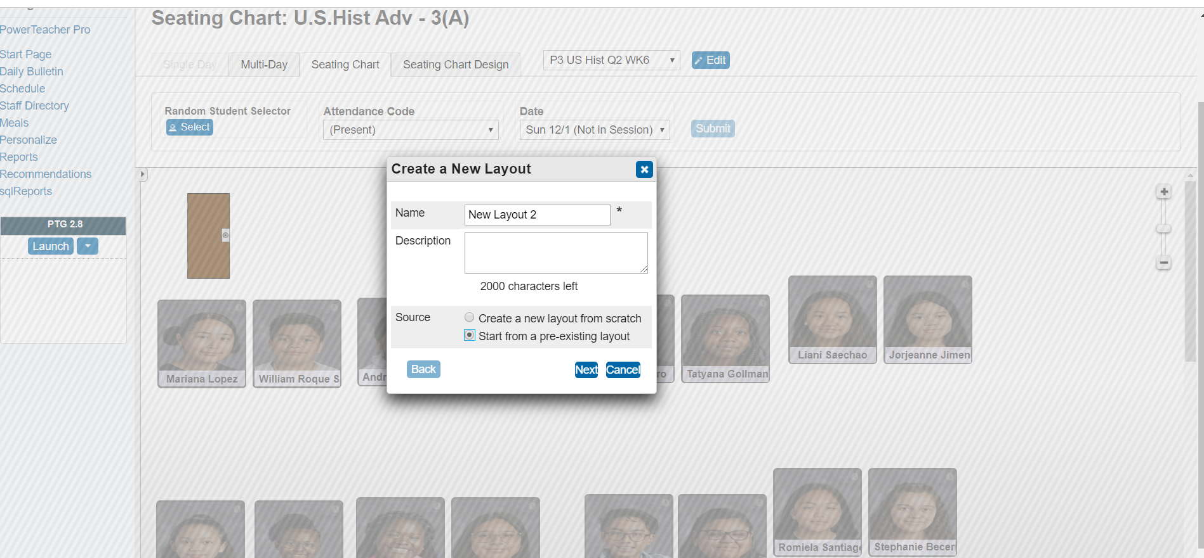
Go to the next period

Slide 14
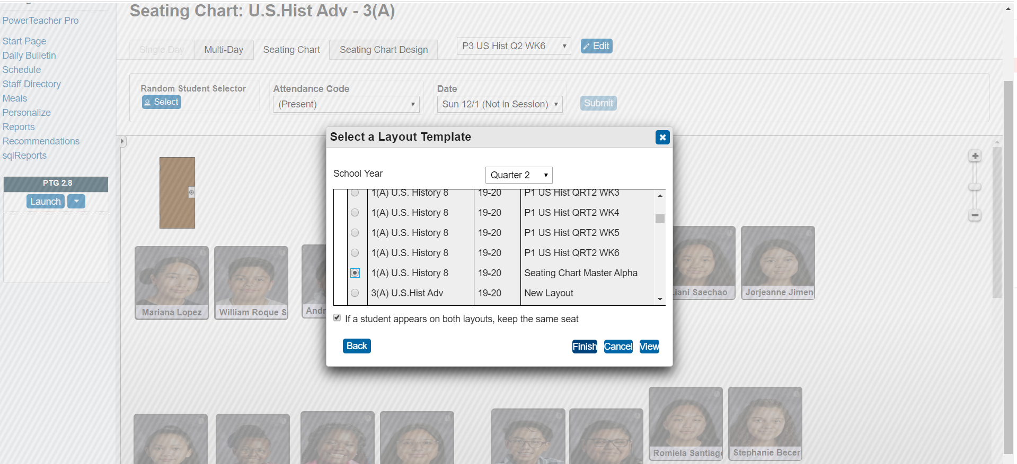
Pick the seating chart master from Period 1

Slide 15
Now you are ready

Slide 16
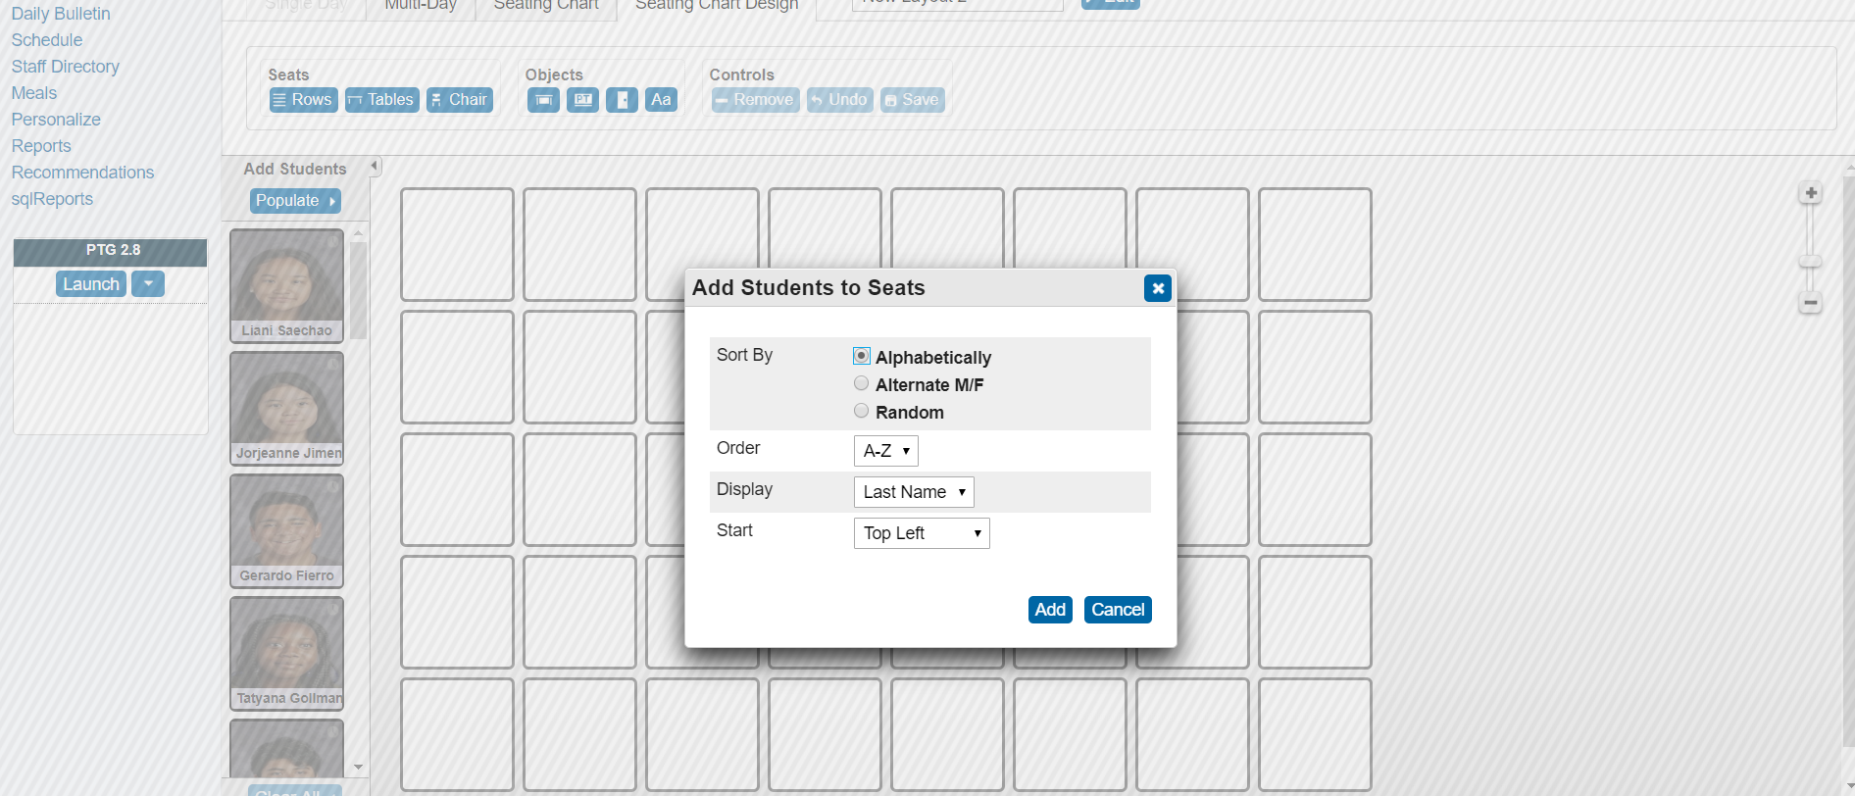
Populate alphabetically

Slide 17
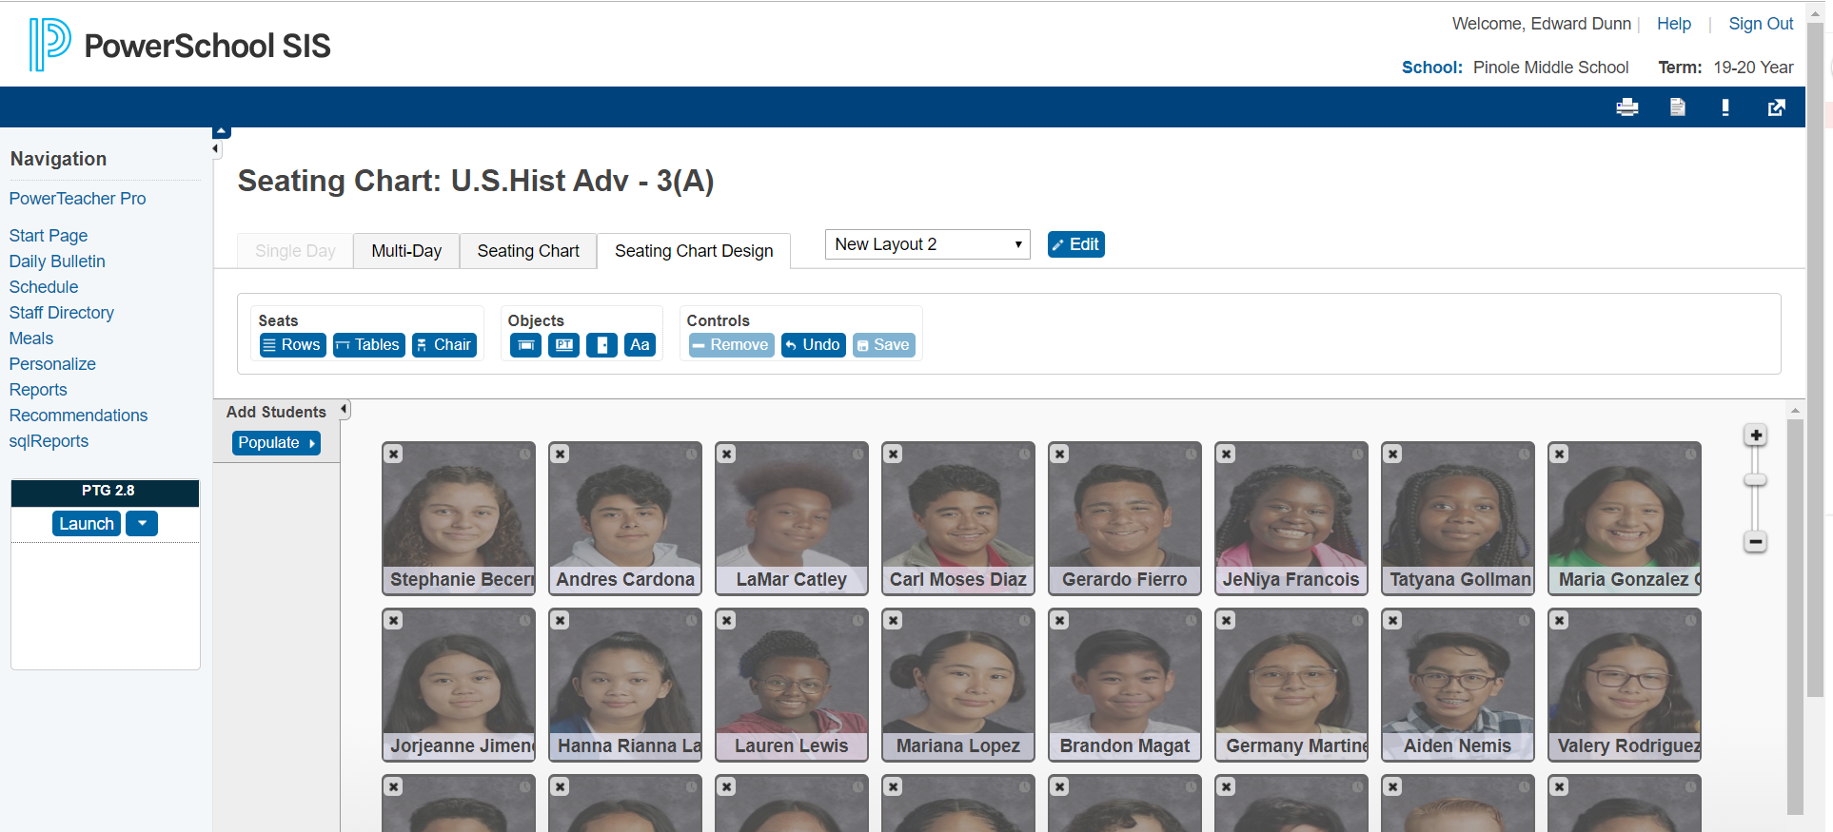
Here is the new set

Slide 18
Don’t forget to save

Slide 19
Now you can print them off

Slide 20
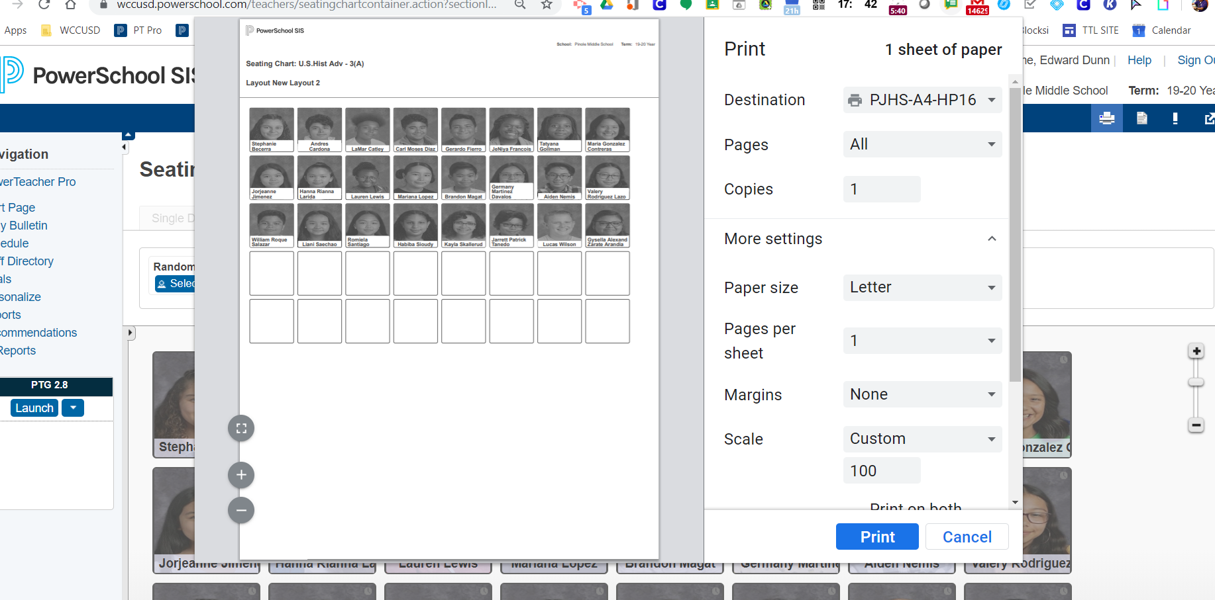
Print settings
Notes:
Start at the PowerSchool home page

